Slide 1

Utsav Sen
Arun Jayakumar
Meenakshi Mocherla
Priyanka Thacker
Suren Sughand

Slide 2
Background
Founded by Steve Jobs, Steve Wozniak, and Ronald Wayne in April 1976.
Initial purpose was to sell Wozniak’s Apple I personal computer.
Went public in 1980 to instant financial success.
Launched the first iPhone in 2007.
The company currently employees 123,000 full-time employees and maintains 504 retail stores in 24 countries.
First public U.S. company to be valued at over $1 trillion in August 2018.

Slide 3
Dataset
Our dataset comprises of Apple’s opening and closing stock prices from 2007 to 2018. We chose this dataset for our project to understand underlying trends, seasonality and forecasts for Apple stock in the future.
The dataset contained information that included the high, low, opening, and closing stock values spanning from January 1, 2007 to November 30, 2018.

Slide 4
Dataset Caveats
To ensure consistency across years, we found the year with maximum number of trading days (253), and then added the closing value of the previous trading day to the next non-trading to ensure that every year had the same number of records. Therefore, the modified dataset totaled 3015 rows.
For analysis purposes, we divided the data into Training data (80%) and Test data (20%).
There was a stock split of 7:1, that happened on June 9th, 2014. The Kaggle dataset that we started with had values that were not adjusted for this split, hence there was a break in the graph. To avoid this, we switched to the Quantmod dataset, which had already compensated for the split.

Slide 5
Data Splitting (Test & Training)
3015 Total Records
2412 Training Records (80%)
603 Test Records (20%)
Code
appl_training <- window(appl_close_ts, start = c(2010,1), end=c(2016,135))
appl_testing <- window(appl_close_ts, start= c(2016,136), end=c(2018,232))

Slide 6
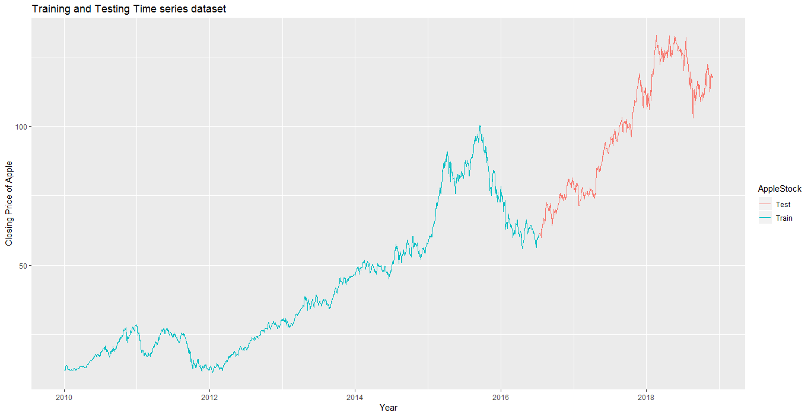
Training & Testing Plot
Code: autoplot(appl_training,series="Train") +autolayer(appl_testing,series="Test") +xlab("Year") + ylab("Closing Price of Apple") + ggtitle("Training and Testing Time series dataset") + guides (colour=guide_legend (title="AppleStock))

Slide 7
Autocorrelation

Slide 8
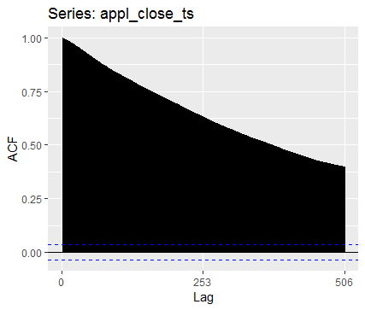
Autocorrelation
Code: ggAcf(appl_close_ts)

Slide 9
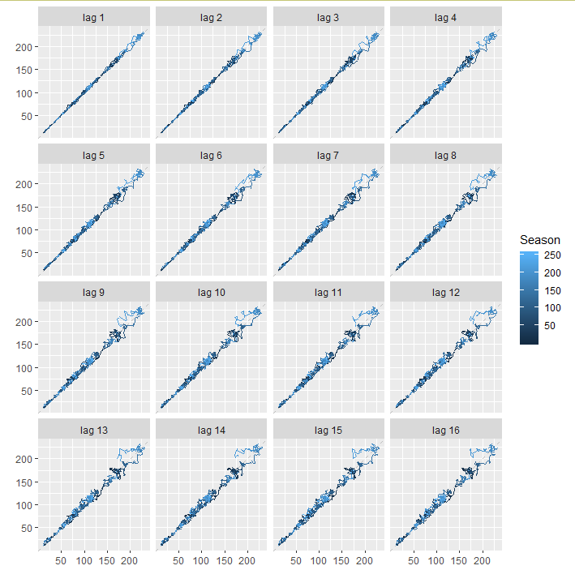
Lag Plots
Code: gglagplot(appl_close_ts)

Slide 10
Decomposition

Slide 11
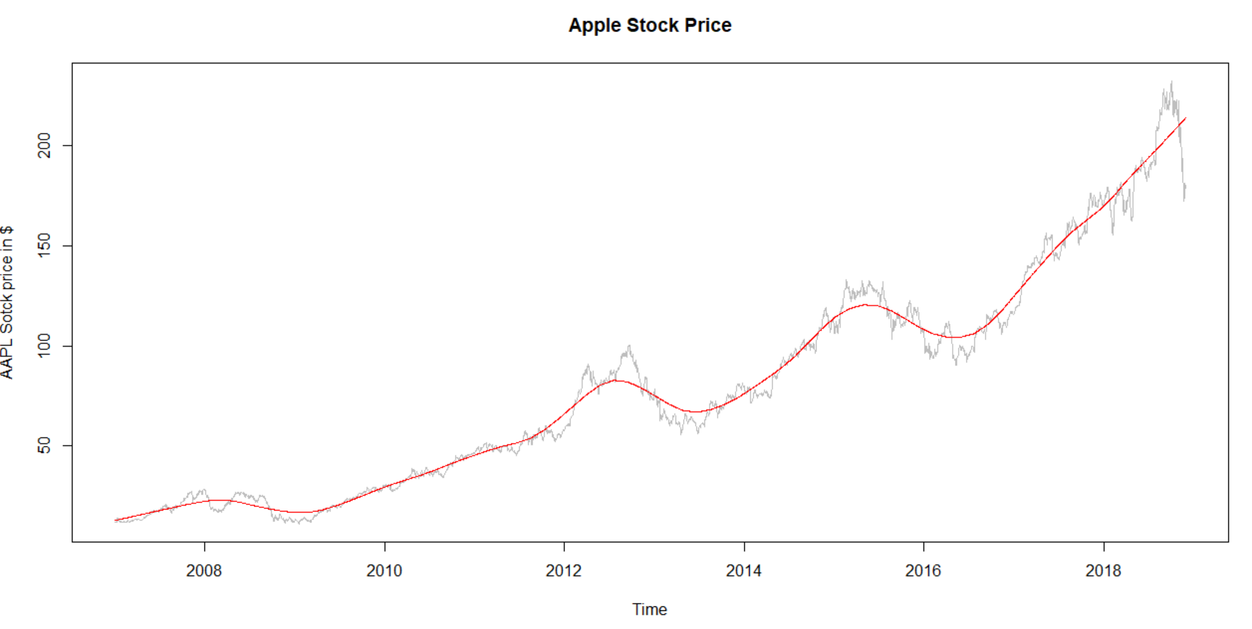
Trend Plotting
Code: plot(appl_close_ts, col="gray", main="Apple Stock Price", ylab="AAPL Sotck price in $", xlab="Time")lines(appl_stl$time.series[,"trend"],col="red",ylab="Trend")

Slide 12
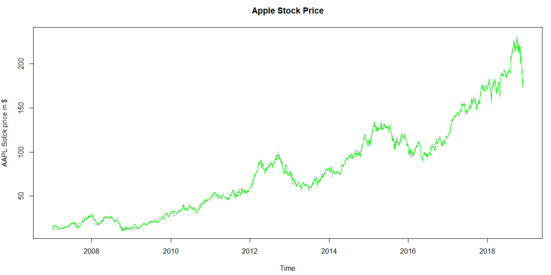
Seasonal Adjustment
Code: plot(appl_close_ts, col="grey", main="Apple Stock Price", ylab="AAPL Stock price in $", xlab="Time") seasadj(appl_stl) lines(seasadj(appl_stl), col="green",ylab="Seasonally adjusted")

Slide 13
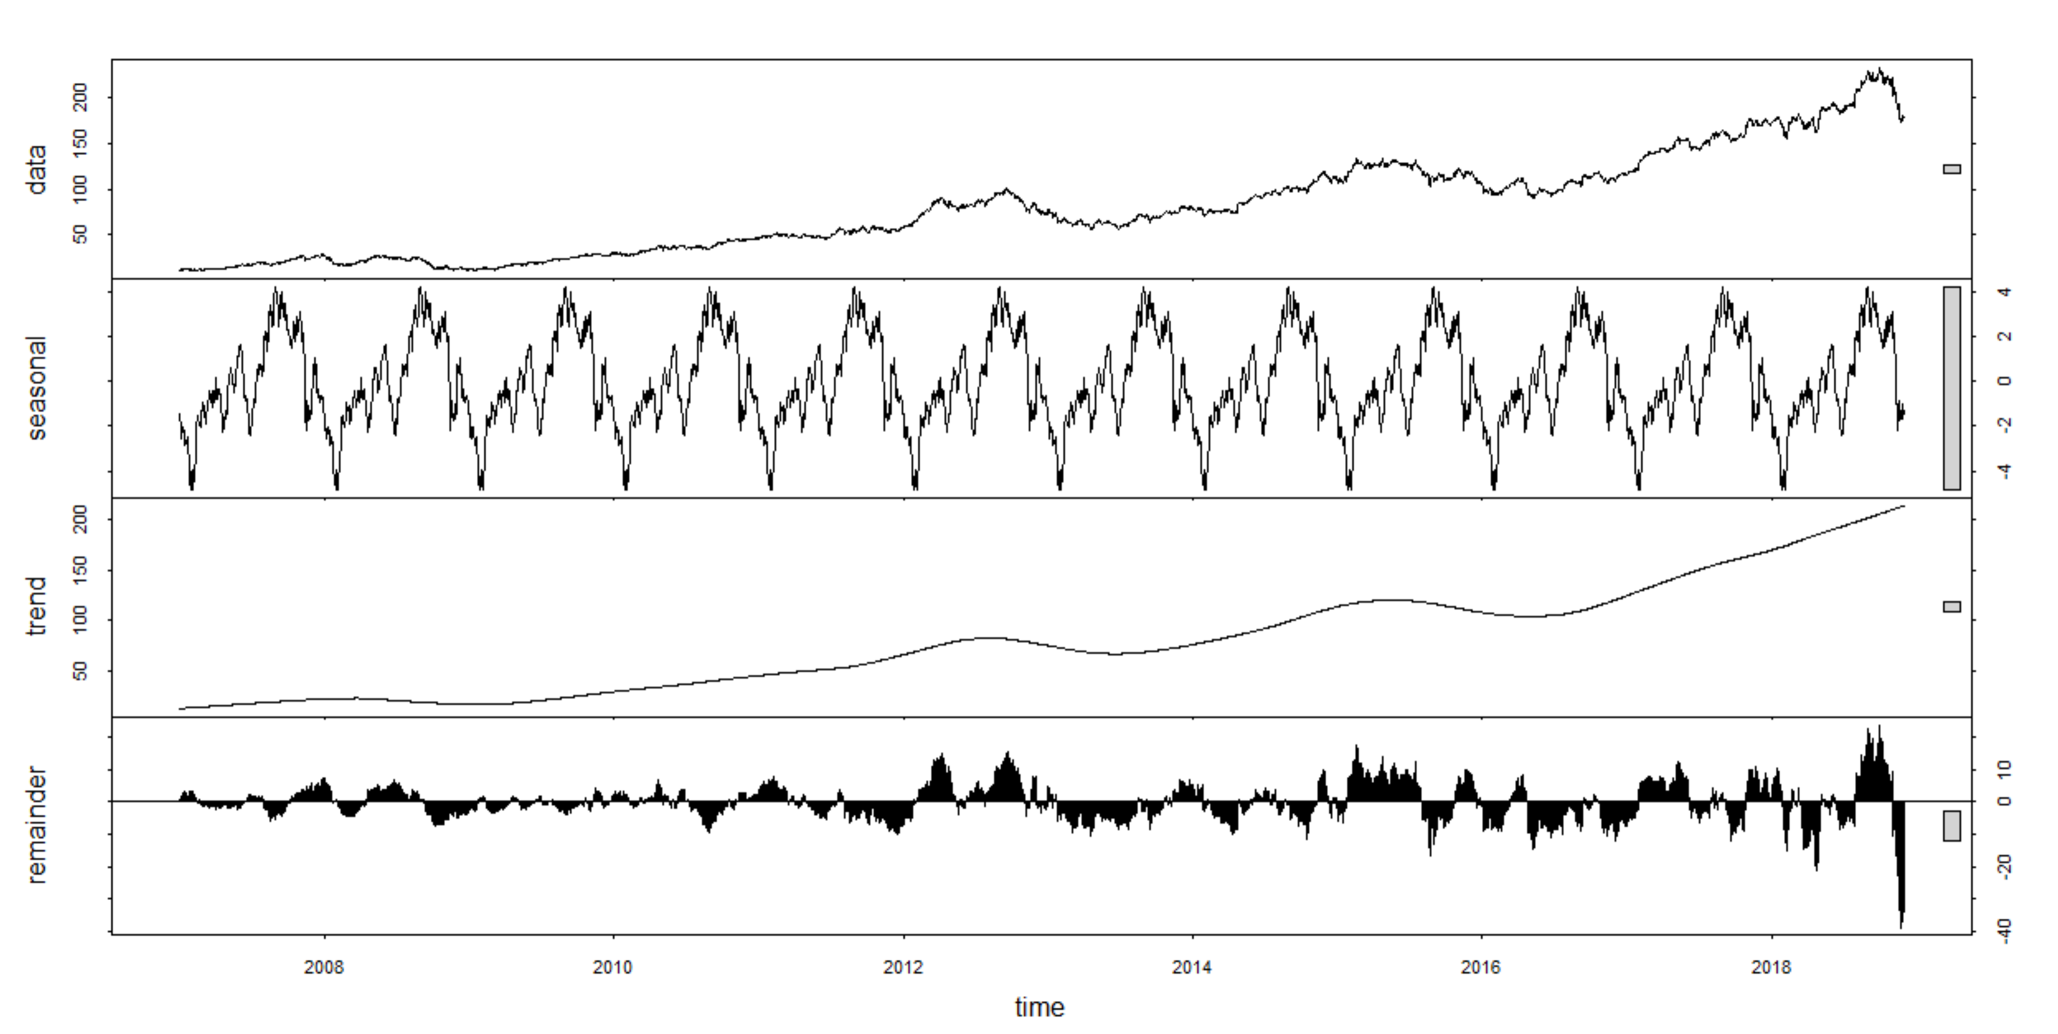
STL Decomposition
Code:
appl_stl<-stl(appl_close_ts, s.window = 5)

Slide 14
Mean Model

Slide 15
Identifying the Mean Model of the Closing Price
In order to generate the mean model, we needed to utilize the meanf function in R on our training data.
Code
appl_mean <- meanf(appl_training,h=603)

Slide 16
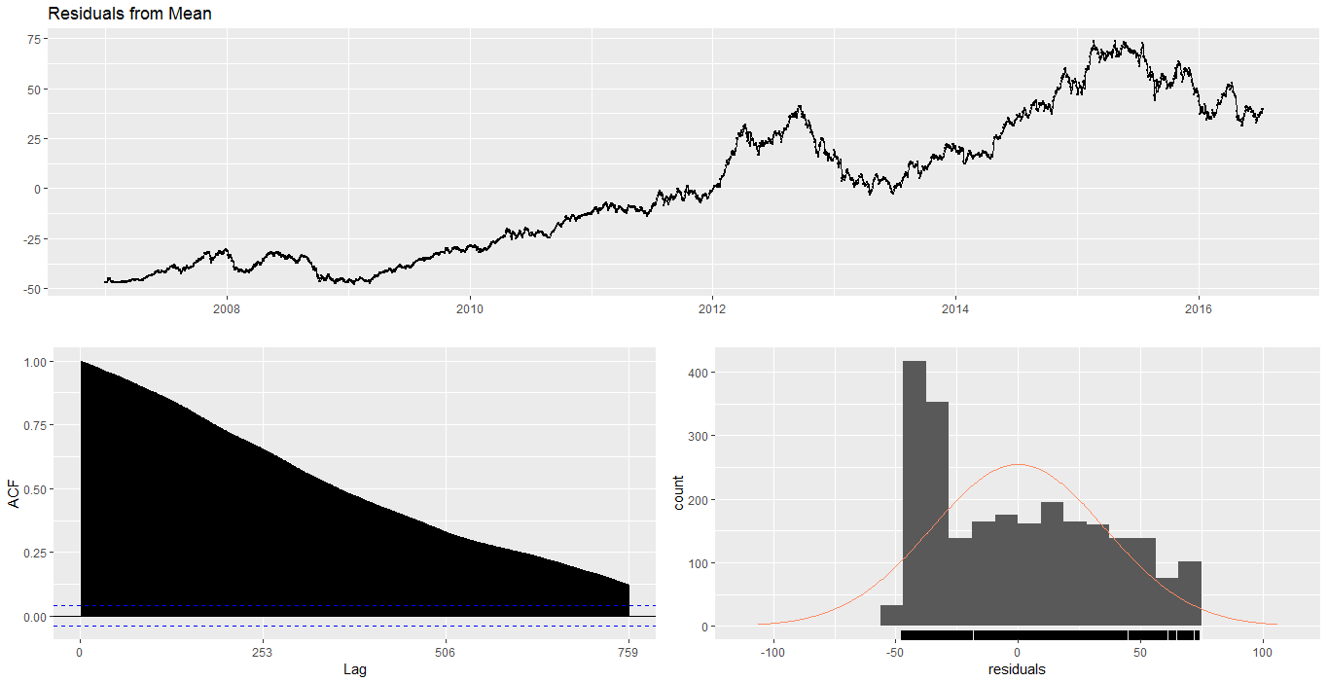
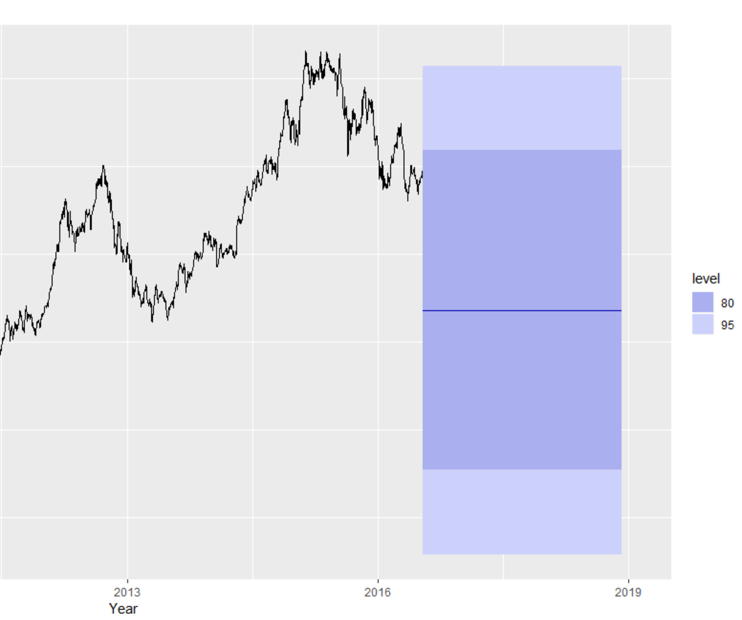
Mean Model
Code:
autoplot(appl_mean) + xlab("Year") + ylab("Closing Price of Apple stock") + ggtitle ("Forecasts from Mean method")
Residuals Output:
Q* = 615500
Df = 481.4
P-value < 2.2e-16
Model Df: 1
Total Lags Used: 482.4

Slide 17
Forecast Accuracy
Code: accuracy(appl_mean, appl_testing)

Slide 18
Naive Model

Slide 19
Identifying the Naive Model of the Closing Price
In order to generate the naive model, we needed to utilize the rwf function in R on our training data.
Code
appl_naive <- rwf(appl_training,h=603)

Slide 20
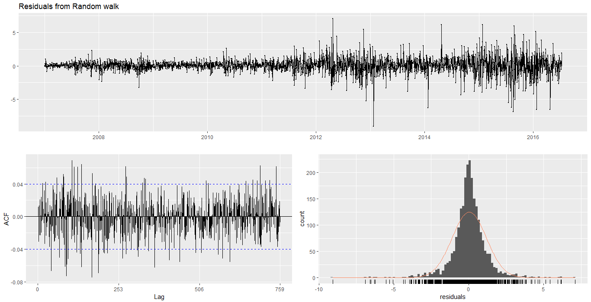
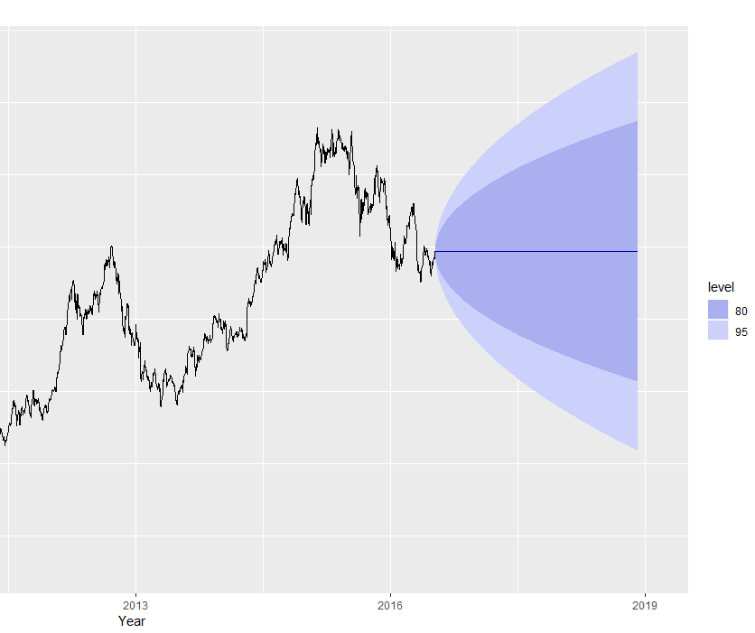
Naive Model
Code:
autoplot(appl_naive) + xlab("Year") + ylab("Closing Price of Apple stock") + ggtitle("Forecasts from Naive method")
Residuals Output:
Q* = 701.68
Df = 482.4
P-value < 2.371e-10
Model Df: 0
Total Lags Used: 482.4

Slide 21
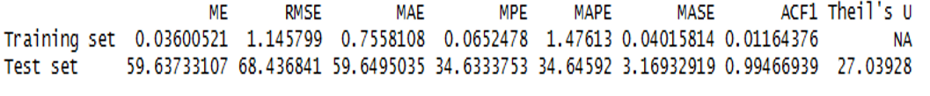
Forecast Accuracy
Code: accuracy(appl_naive, appl_testing)

Slide 22
Seasonal Naive Model

Slide 23
Identifying the Seasonal Naive Model of the Closing Price
In order to generate the seasonal naive model, we needed to utilize the snaive function in R on our training data.
Code
appl_snaive <- snaive(appl_training,h=603)

Slide 24
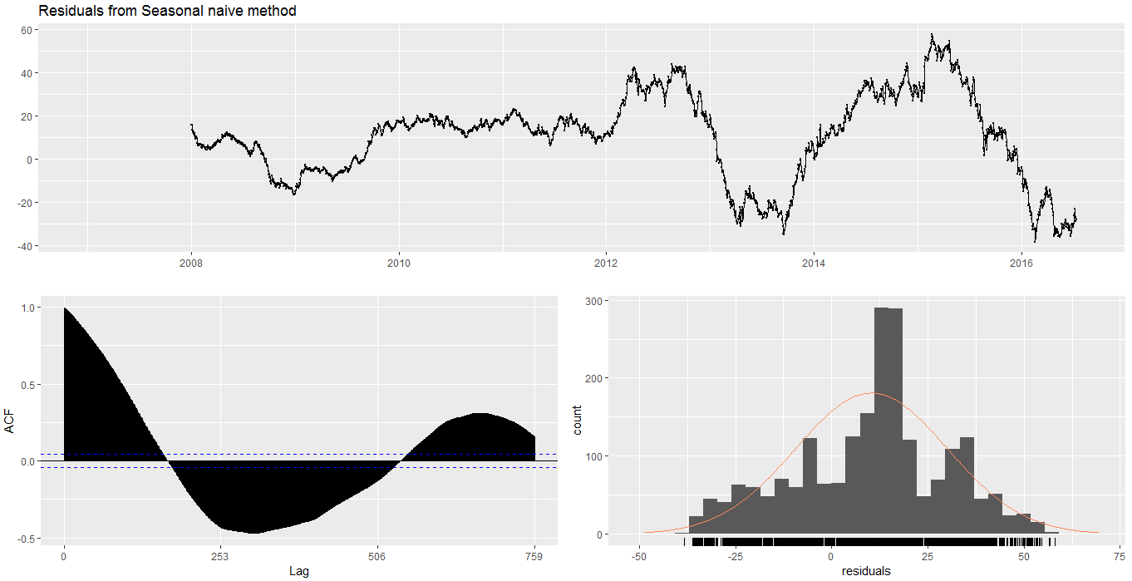
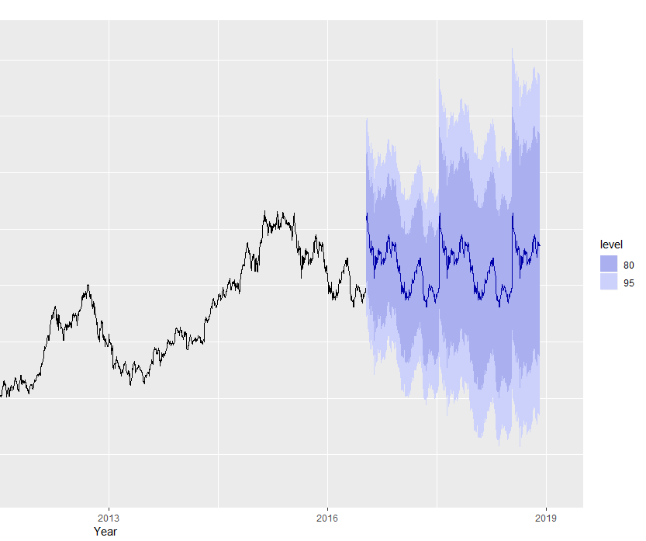
Seasonal Naive Model
Code:
autoplot(appl_snaive) + xlab("Year") + ylab("Closing Price of Apple stock") + ggtitle("Forecasts from Seasonal Naive method")
Residuals Output:
Q* = 249980
Df = 482.4
P-value < 2.2e-16
Model Df: 0
Total Lags Used: 482.4

Slide 25
Forecast Accuracy
Code: accuracy(appl_snaive, appl_testing)

Slide 26
Drift Model

Slide 27
Identifying the Drift Model of the Closing Price
In order to generate the Drift model, we needed to utilize the rwf function in R with Drift=TRUE on our training data.
Code
appl_drift <- rwf(appl_training,h=603,drift=TRUE)

Slide 28

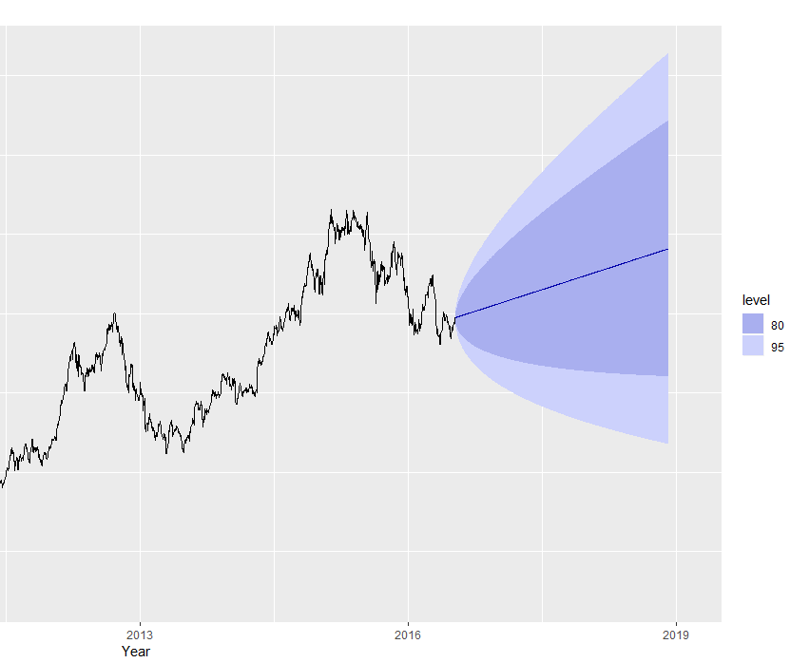
Drift Model
Code:
autoplot(appl_drift) + xlab("Year") + ylab("Closing Price of Apple stock") + ggtitle("Forecasts from Drift method")
Residuals Output:
Q* = 530.45
Df = 329.6
P-value < 1.378e-11
Model Df: 1
Total Lags Used: 330.6

Slide 29
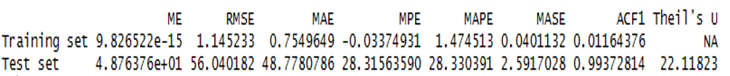
Forecast Accuracy
Code: accuracy(appl_drift, appl_testing)

Slide 30
Multiple Regression

Slide 31
Identifying the Multiple Regression Model of the Closing Price
In order to generate the Multiple Regression model, we needed to utilize the tslm function in R to denote the time series relationship.
The next step is to forecast the future stock prices using the forecast function.
Code
appl_reg <- tslm(appl_training ~ trend + season)
appl_reg_forecast <- forecast(appl_reg, h= 603)

Slide 32
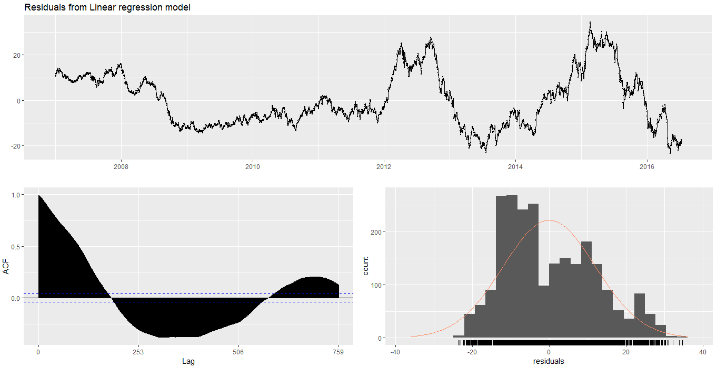
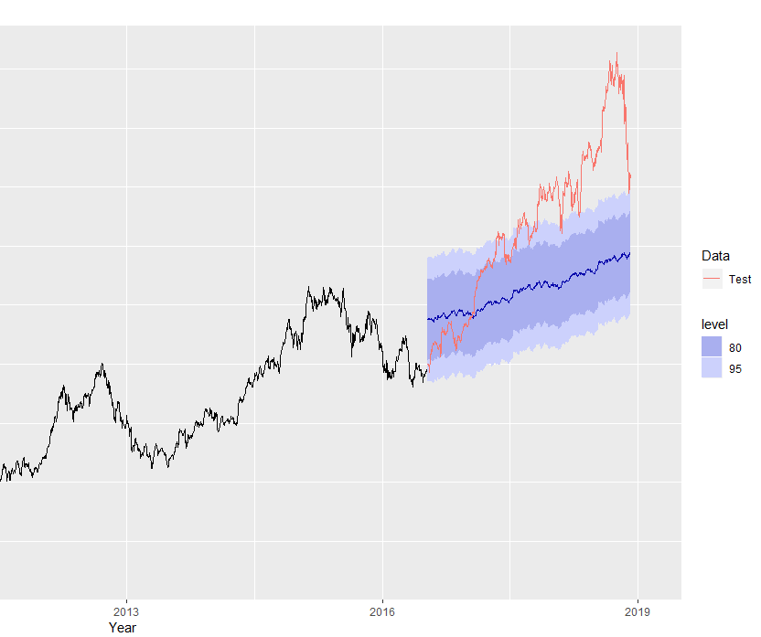
Multiple Regression Model
Code:
autoplot(appl_reg_forecast) + autolayer(appl_testing, series = "Test") + xlab("Year") + ylab("Closing Price of Apple stock") + ggtitle("Forecasts of Apple stock closing price using regression") + guides(colour = guide_legend(title = "Data"))
Residuals Output:
LM Test = 2397.2
Df = 482
P-value < 2.2e-16

Slide 33
Forecast Accuracy
Code: accuracy(appl_reg_forecast, appl_testing)

Slide 34
Holt Linear Model

Slide 35
Identifying the Holt Linear Model of the Closing Price
In order to generate the Holt Linear model, we needed to utilize the holt function in R to denote the linear trend.
We also have to identify the smoothing parameters.
Code
appl_holt <- holt(appl_training, h= 603)
appl_holt[["model"]]

Slide 36
Smoothing Parameters
Below are the Smoothing parameters.
Smoothing Parameters
Alpha = 0.9999
Beta = 1e-04
Initial States
I = 13.3848
B = 0.0316
Sigma
1.1464
AIC, AICc, BIC
AIC = 19450.20
AICc = 19450.23
BIC = 19479.15

Slide 37
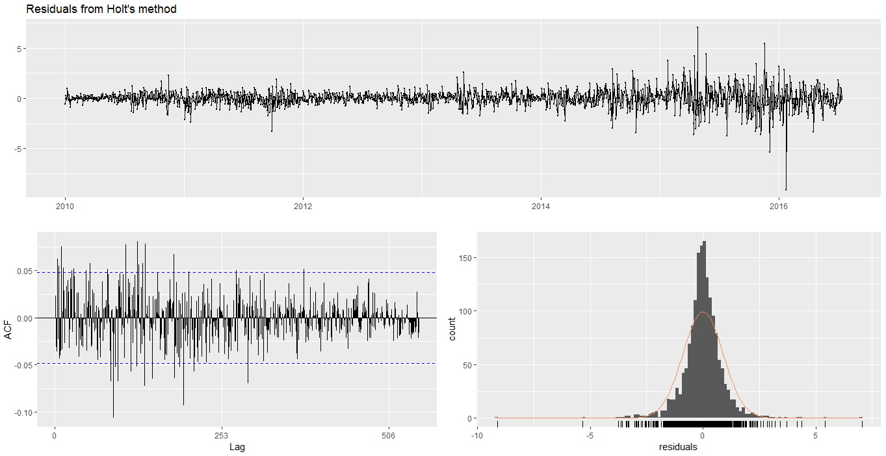
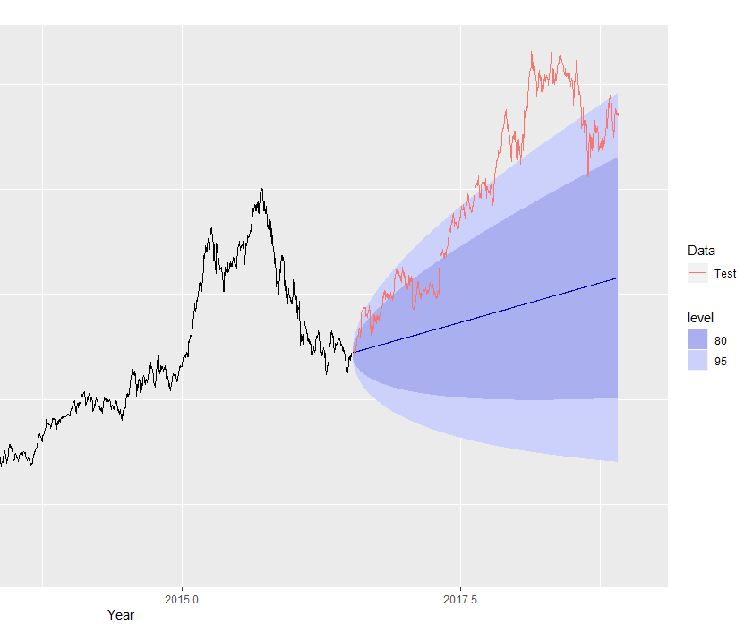
Holt Linear Model
Code:
autoplot(appl_holt, series = "Forecast") + autolayer(appl_testing, series = "Test") + xlab("Year") + ylab("Closing Price of Apple stock") + ggtitle("Forecasts of Apple stock closing price using regression") + guides(colour = guide_legend(title = "Data"))
Residuals Output:
Q* = 701.59
Df = 478.4
P-value = 1.105e-10
Model DF: 4
Total Lags Used: 482.4

Slide 38
Forecast Accuracy
Code: accuracy(appl_reg_forecast, appl_testing)

Slide 39
ARIMA Model

Slide 40
Identifying the ARIMA Model of the Closing Price
In order to generate the ARIMA model, we needed to consolidate the dataset based off our time period.
We then ran the auto.arima function in R in order to determine the ARIMA model with best fit.
Code
library(readxl)
projectData <- readxl::read_excel(path = "C:/Users/aapl.xlsx",sheet = "AAPL.Close_Updated" )
aapl_close <- projectData$AAPL.Close
aapl_close_ts <- ts(data=aapl_close, frequency=253, start=c(2007,1))
aapl_training <- window(aapl_close_ts, start =c(2007,1), end=c(2016,135))
aapl_testing <- window(aapl_close_ts, start= c(2016,136),end=c(2018,232))
fit <- auto.arima(aapl_training)

Slide 41
ARIMA Output
Below is the output of the ARIMA model using the auto.arima function.
ARIMA
ARIMA(0,1,0) with Drift
Coefficients
Drift = 0.0360
Standard Error = 0.0233
Sigma²
1.312
AIC, AICc, BIC
AIC = 7500.02
AICc = 7500.03
BIC = 7511.6
Log Likelihood
3748.01

Slide 42

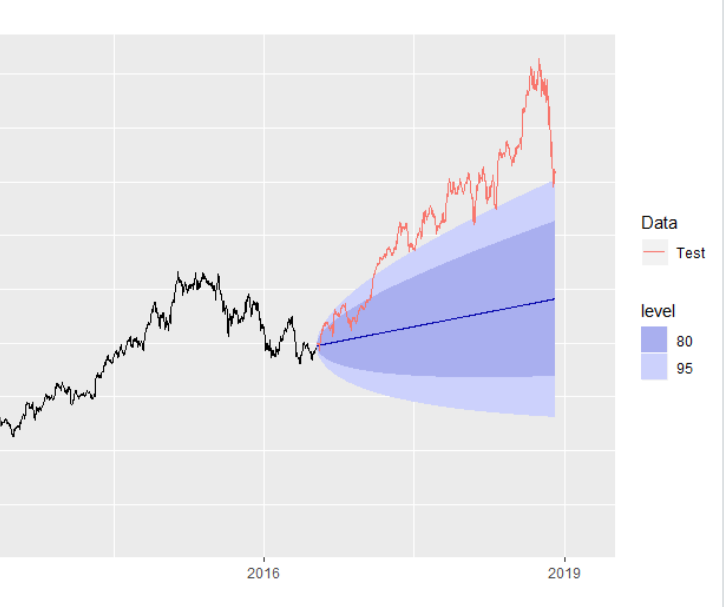
ARIMA Model
Code:
autoplot(aapl_arima, series = "Forecast") + autolayer(aapl_testing, series = "Test") + xlab("Year") + ylab("Closing Price of Apple stock") + ggtitle("Forecasts of Apple stock closing price using Arima(0,1,0)") + guides(colour = guide_legend(title = "Data"))
Residuals Output:
Q* = 701.95
Df = 481.4
P-value = 2.271e-10
Model DF: 0
Total Lags Used: 482.4

Slide 43
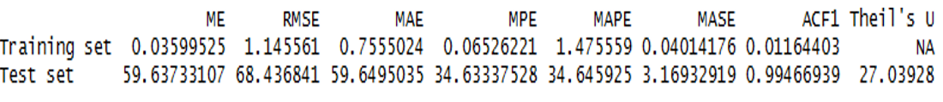
Forecast Accuracy
Code: accuracy(appl_reg_forecast, appl_testing)

Slide 44
Conclusion

Slide 45
For Naïve Method:
For Drift Method:
For Holt’s Linear Method:
For ARIMA with Drift:
Drift RMSE is the lowest!

Slide 46
Questions?

